Slide 1
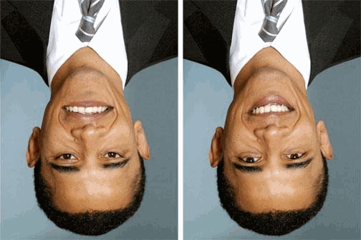
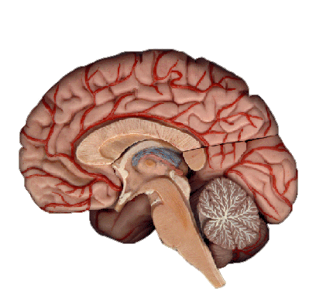
The Neocortex
Notes:
1) CLICK The Neocortex in GREEN is the part of your brain that makes you intelligent!
2) The other parts that are not in GREEN is what you have in common with your alligator friends. But the Neocortex is what allows you to...
3) CLICK Do math problems ...
4) CLICK correct math problems ...
5) CLICK
6) CLICK It also allows us to focus on what is really important!
7) all of your regrets, inspirations, passions and dreams exist as the strength of connections between the billions of neurons in your NEOCORTEX

Slide 2
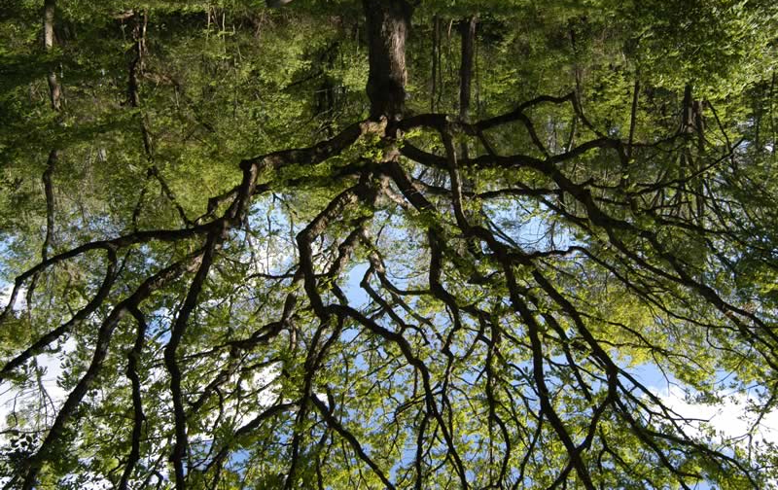
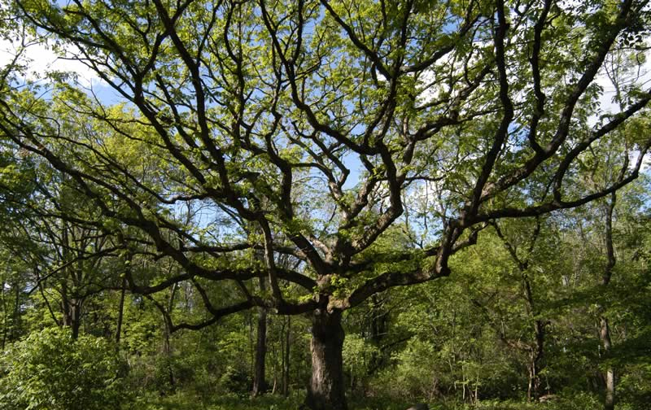
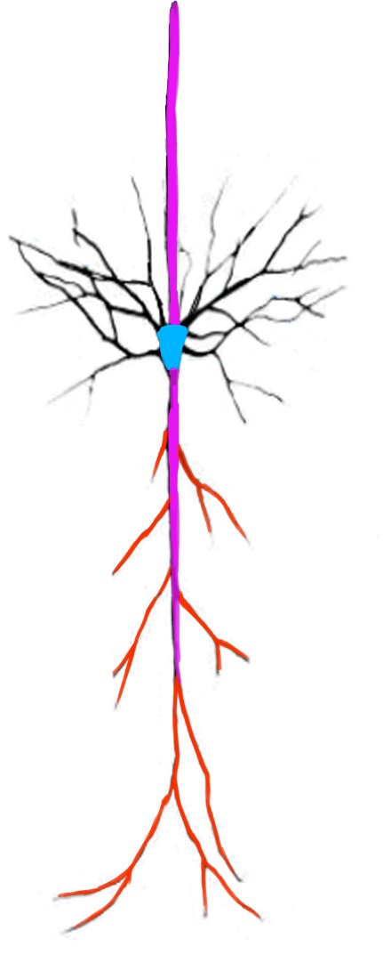
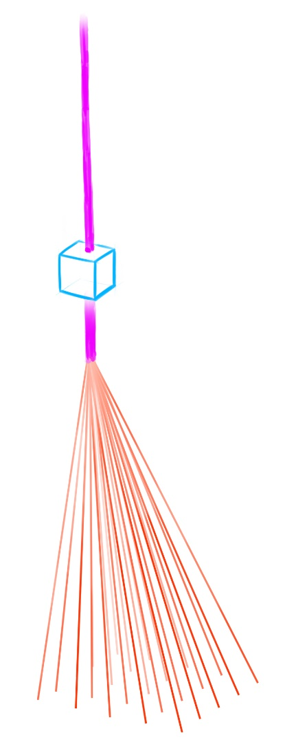
Structure of Neocortex
Notes:
CLICK First imagine a forest of trees.
CLICK Now imagine that forest turned upside down.
CLICK Now how one tree is structured is exactly how a neuron in your neocortex (80%) of your brain is structured.
CLICK Now I am going to further simplify it and removing the connections to neurons in the same layer
Now your brain does many things but I am going to use this is the model I drew to explain object recognition

Slide 3
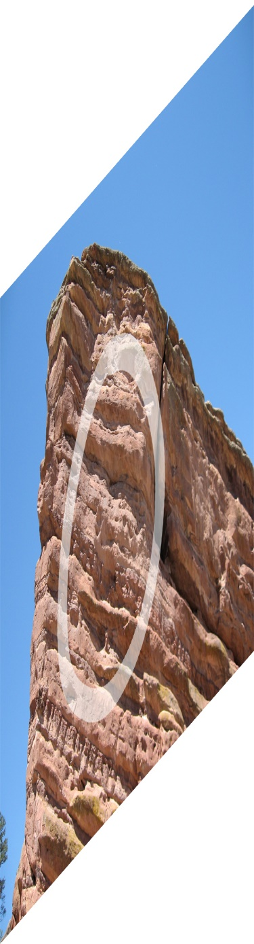
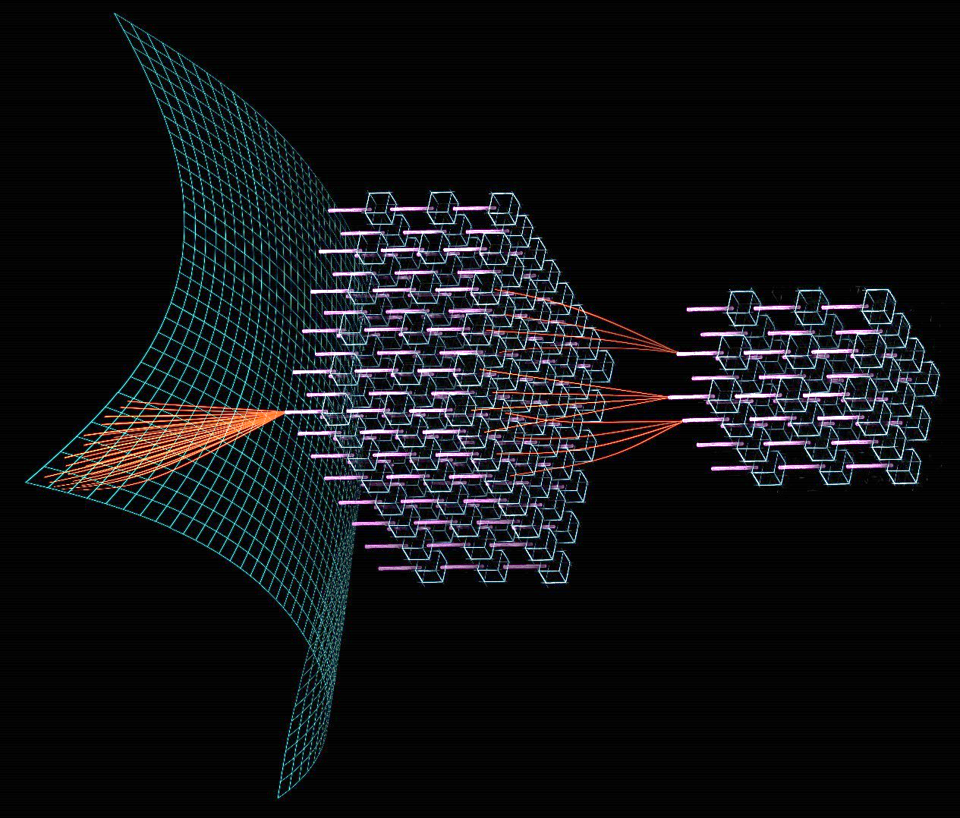
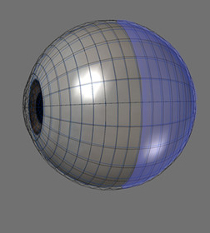
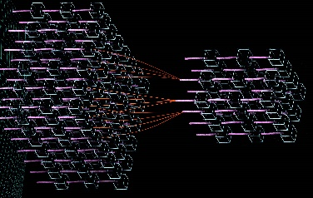
How Do You Recognize Objects?
Notes:
So first how does visual pathway structured?
CLICK Let’s say your looking at a mountain with a zero on it
CLICK Here is your eye
CLICK This is structure of your neocortex, your actual neocortex is just a whole bunch of more neurons. So where is the within your actual brain
CLICK So here is your brain
CLICK That is where the structure is within your brain
CLICK And that is how your eye is connected to your neocortex

Slide 4
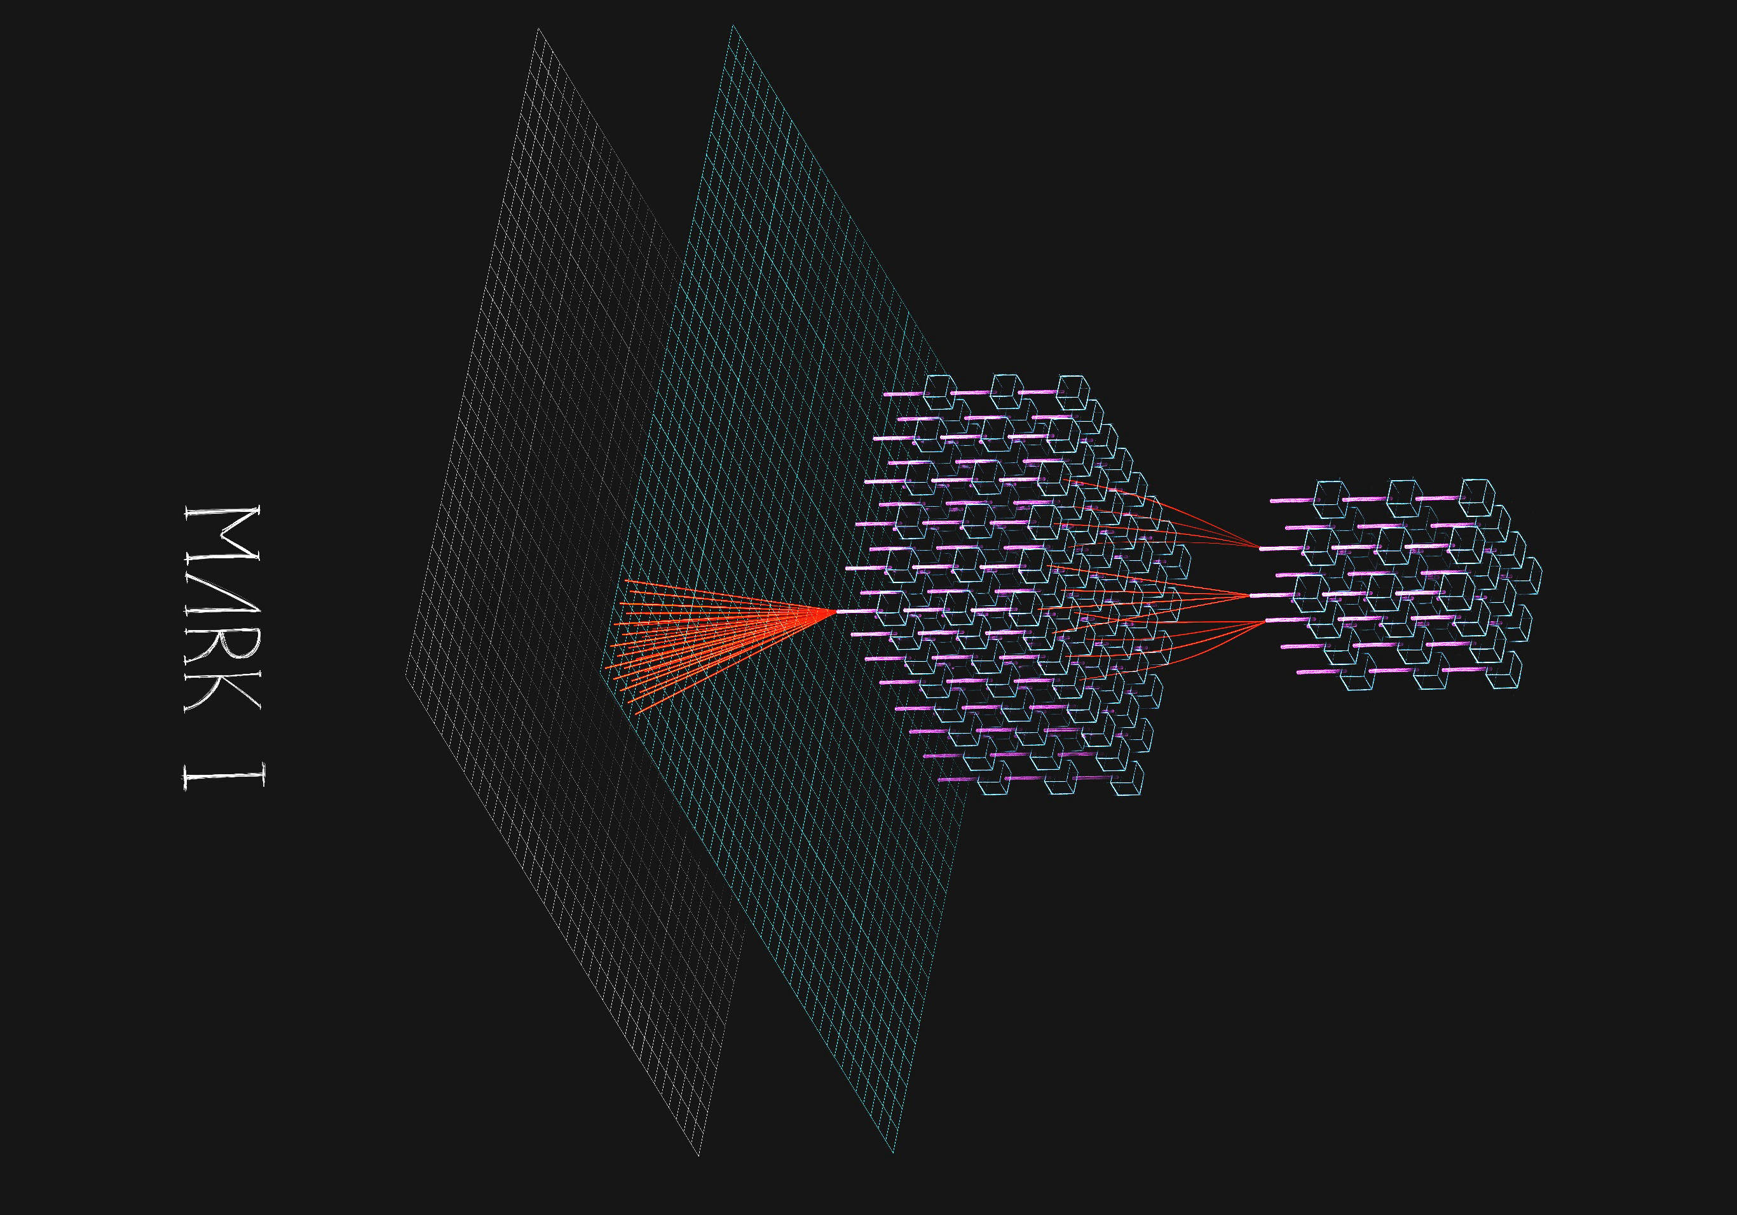
Recognizing an object
Notes:
CLICK So here have our model of the brain
CLICK The Grey sheet represents reality
CLICK The flat Blue Green sheet represents your eye
CLICK The rubix cubes of neurons represent your neocortex

Slide 5
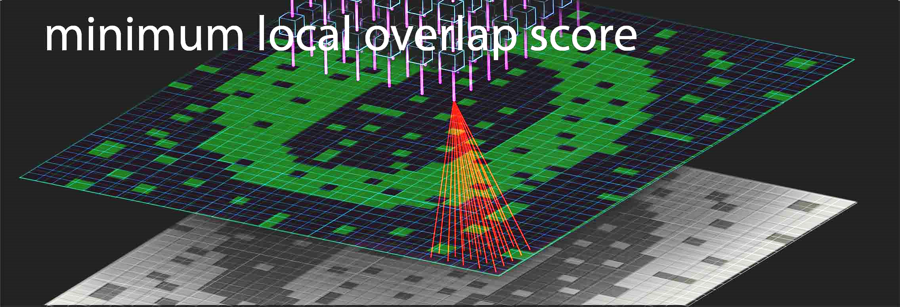
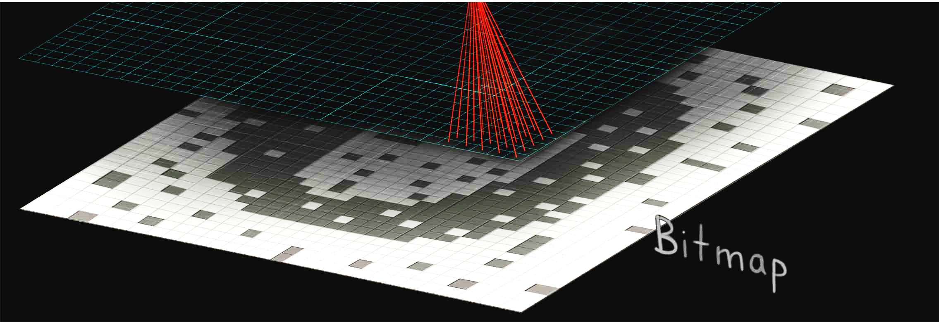
Notes:
So as an example of how object recognition works, let’s say you are looking at an circle. With some random noise.
CLICK So now your reality is being projected to cells being active in your eye

Slide 6
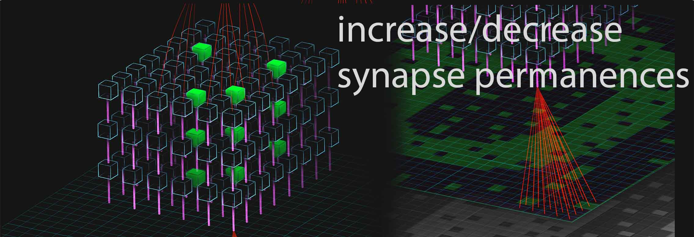
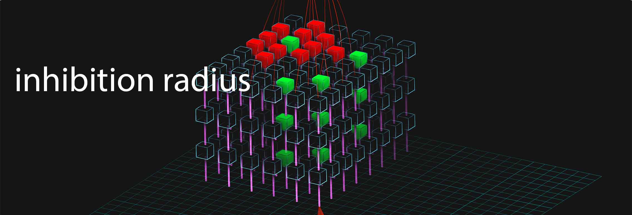
Notes:
inhibition radius
CLICK increase/decrease permanences

Slide 7

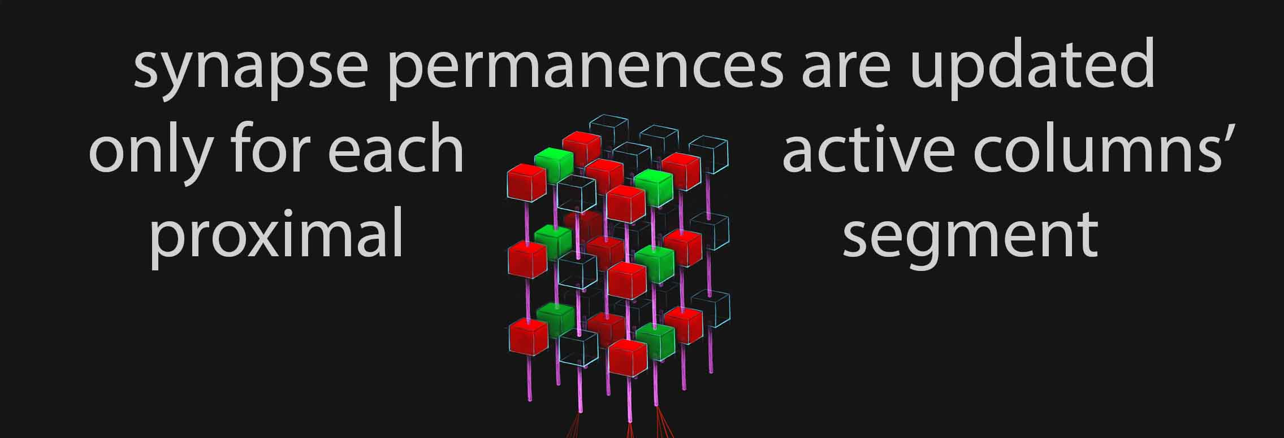
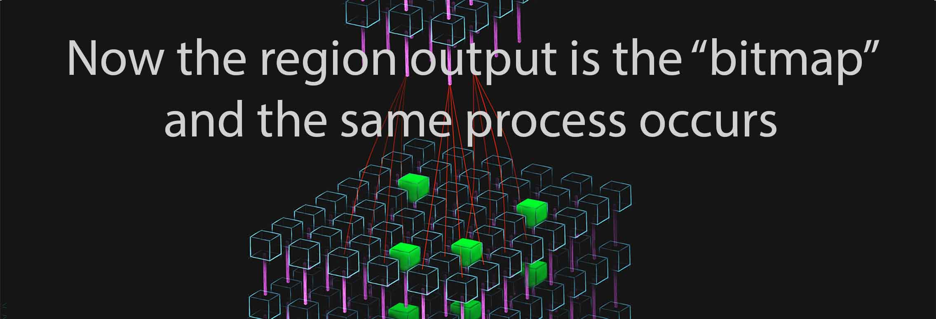
Notes:
region output
CLICK certain connections get stronger
3) CLICK what you get is that the sequence of neurons that became active to get to this point represent an idea.

Slide 8
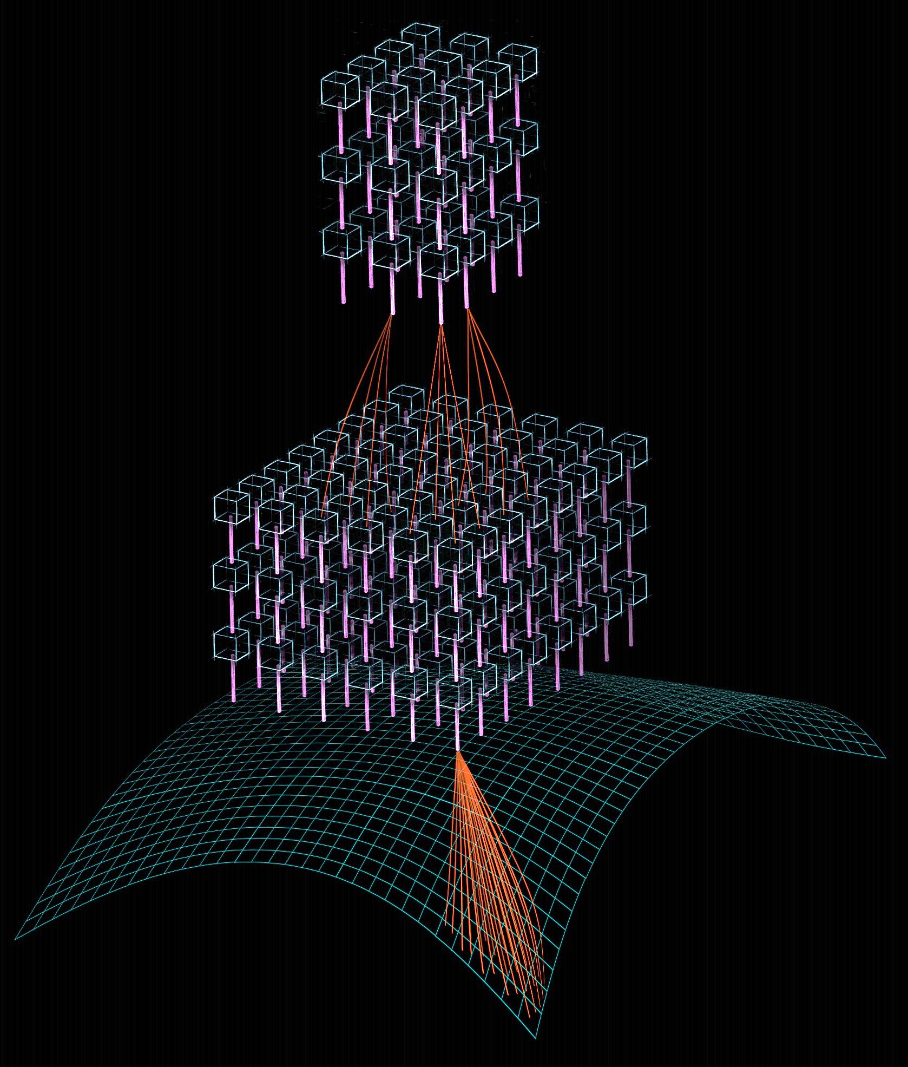
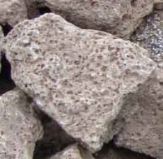
Notes:
And if you train a brain long enough, you will give it many ideas where simpler ideas are represented as cells in the lower region
CLICK For example rocks will be represented in lower regions than
CLICK rock walls, and complex ideas like belaying are above neurons that represent rope

Slide 9
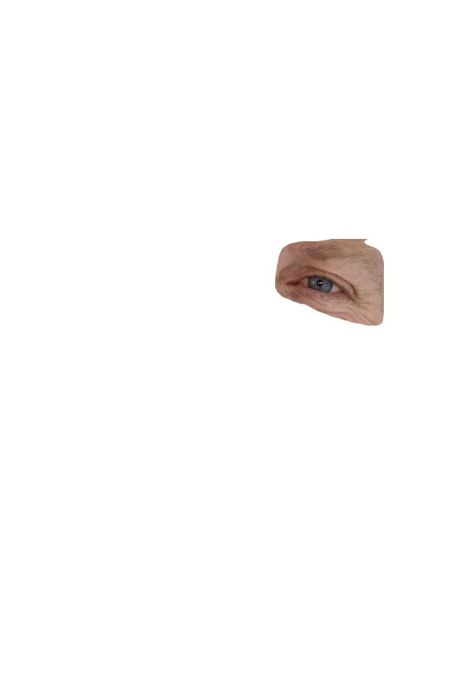
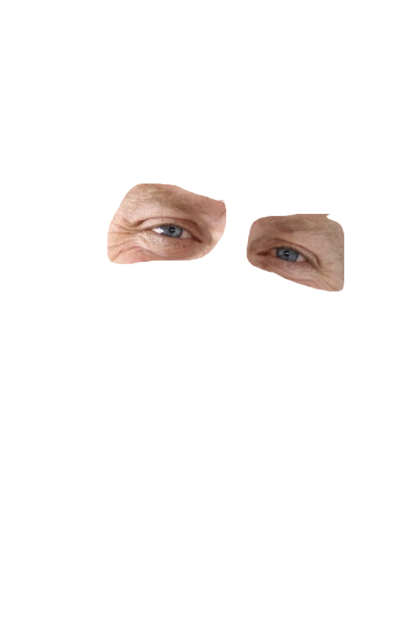
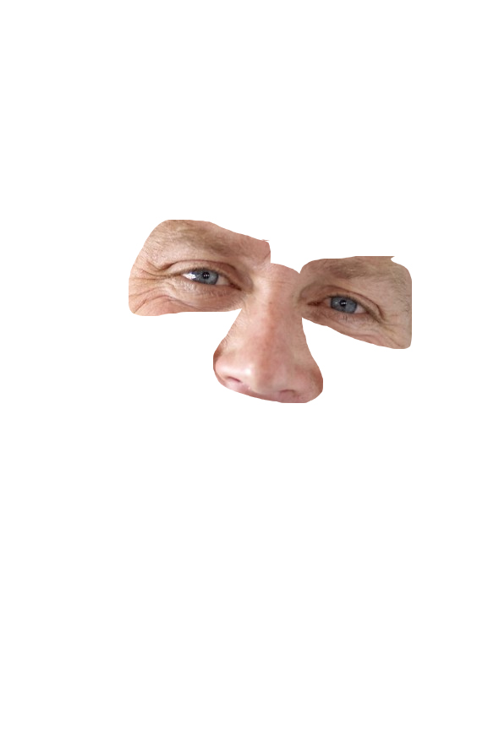
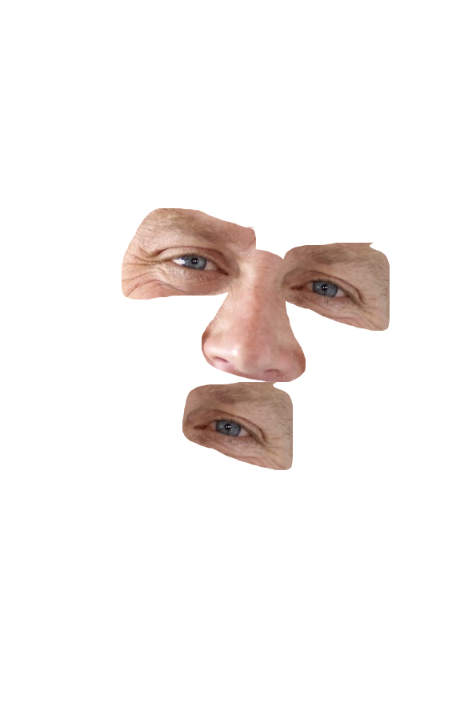

What else does your brain do?
Makes predictions
Notes:
Now the other main thing that your neocortex does besides recognize objects is that it makes predictions
Right now as I finish the words that are in this ... “sentence” your brain without your control though about the word “sentence” even before I said it.
When you look at a face, what your eyes do is that it first looks at one part of the face like the eye CLICK
then when it looks to the left it expects to see another eye CLICK
then when it looks a little lower it expects to see a nose CLICK
and finally when it looks a little lower it expects to see a mouth CLICK
And then do you actually know what the person’s face looks like
I don’t have time to go into detail about how your brain makes predictions but just to summarize
your brain first recognizes what’s it’s looking at, then it makes predictions about the future, and the neurons that become active in your brain become your motor output, whether it is through moving muscles in your neck to create speech or muscles in your hand to make gestures.

Slide 10
THANKS!
Details at www.walnutiq.com! (Under BRAIN SIMULATION Tab)
Notes:
View all the source code, and technical details at my website www.walnutiq.com
2) Thank you for your time!

